Slide 1

Machine learning project on Heart attack prediction
SunnapurallaBhargavi

Slide 2
About Me: I am pursuing 3rd year B.Tech in branch of Artificial Intelligence and Data Science in Aditya college of Engineering ,Madanapalli. I’m working as a Data science intern at Internx.
Experience: I am currently doing my internship on Data Analysis and Machine learning , gaining valuable hands-on experience and insights into real-world applications of these technologies.
http://www.linkedin.com/in/bhargavi-s-20120b2a1
https://github.com/SunnapurallaBhargavi

Slide 3
Agenda
Objective
Data Description
Data Cleaning
Data Analysis
Splitting data
Normalization
Model Building
Evaluation
Hyper parameter Tuning
conclusion

Slide 4
Objective:
Develop a model to analyze and predict the presence or absence of heart disease based on various risk factors and clinical measurements.
The primary goal is to build accurate and reliable model that can assist in early detection and diagnosis of heart disease.

Slide 5
Data Description
age - Age of the person.
gender - Gender of the person.
0:Male
1:Female
Chest Pain - Chest Pain type:
Value 1:typical angina
Value 2: atypical angina
Value 3: non-angina pain
Value 4: asymptomatic
trtbps - resting blood pressure (in mm Hg).
chol - cholestoral in mg/dl fetched via BMI sensor.
Blood sugar - (fasting blood sugar > 120 mg/dl) (1 = true; 0 = false).
restecg - resting electrocardiographic results.
Value 0: normal
Value 1: having ST-T wave abnormality (T wave inversions and/or ST elevation or depression of > 0.05 mV)
Value 2: showing probable or definite left ventricular hypertrophy by Estes' criteria
max_hr - maximum heart rate.

Slide 6
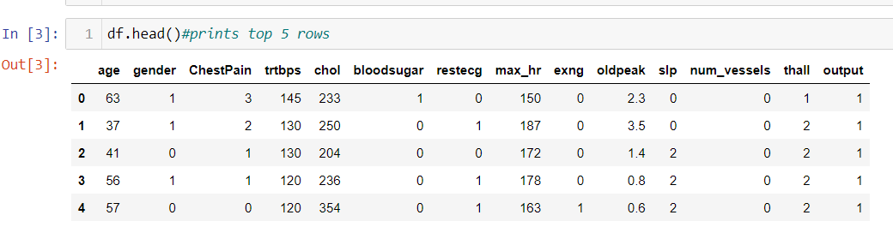
Data Description
exng - exercise induced angina (1 = yes; 0 = no).
old peak - Previous peak
Slope:
0:upsloping
1:flat
2:downsloping
num_vessels- number of major vessels (0-3).
thall - Thal rate:
0:normal 0
1:normal 1
2:fixed defect
3:reversable defect
output- Target variable:
0= less chance of heart attack
1= more chance of heart attack

Slide 7
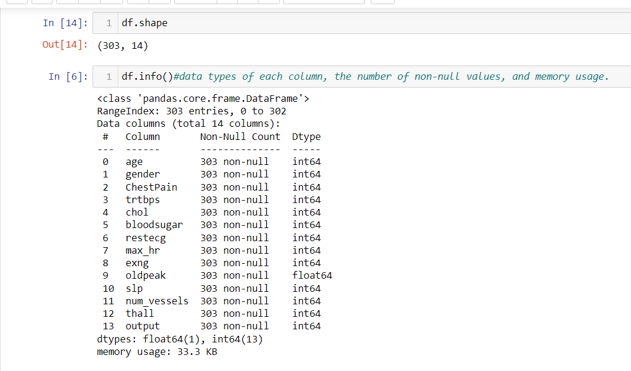
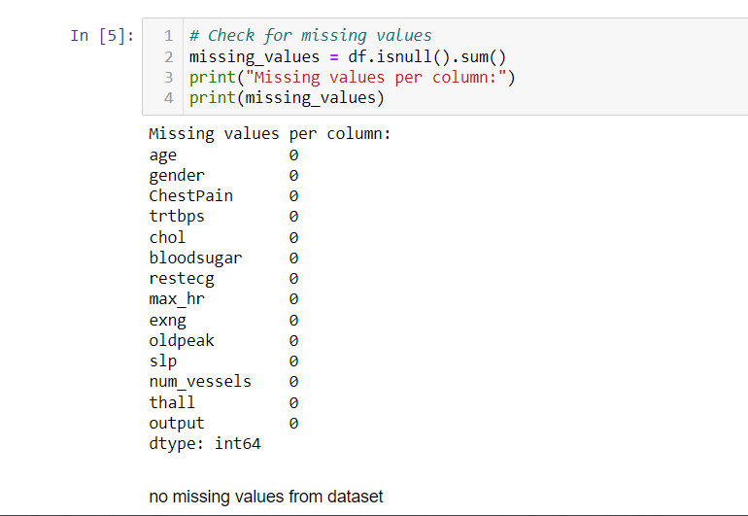
Data Cleaning
Data frame consists of 303 rows and 14 columns.
One row having duplicate values those are dropped .
No missing values in dataset

Slide 8
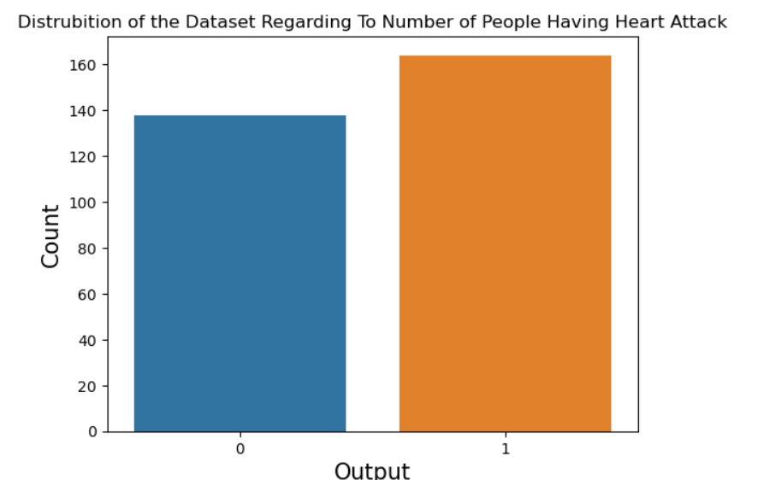
Data Analysis

Slide 9
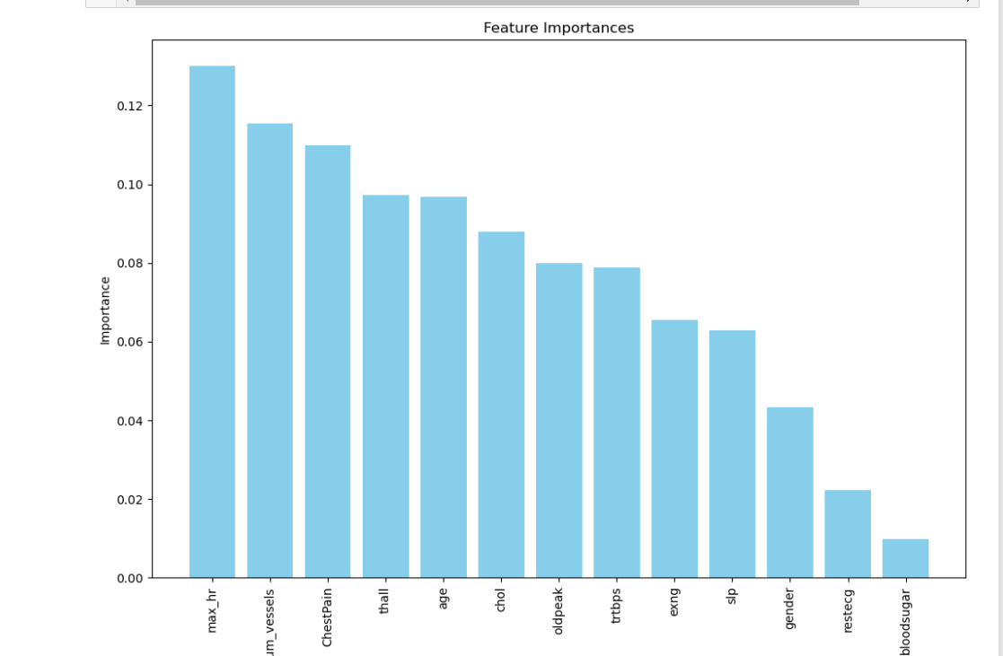
Feature Importance

Slide 10
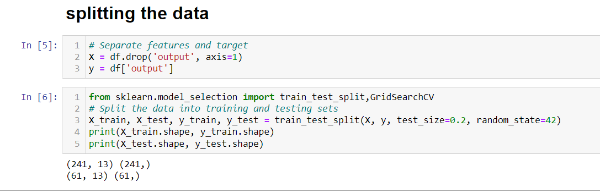
Splitting the Data

Slide 11
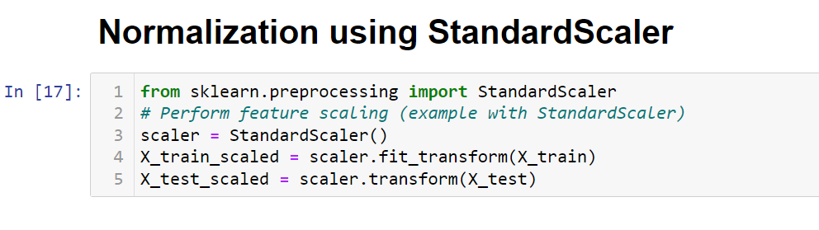
Normalization

Slide 12

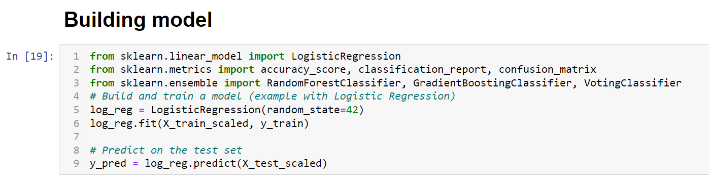
Building a model

Slide 13
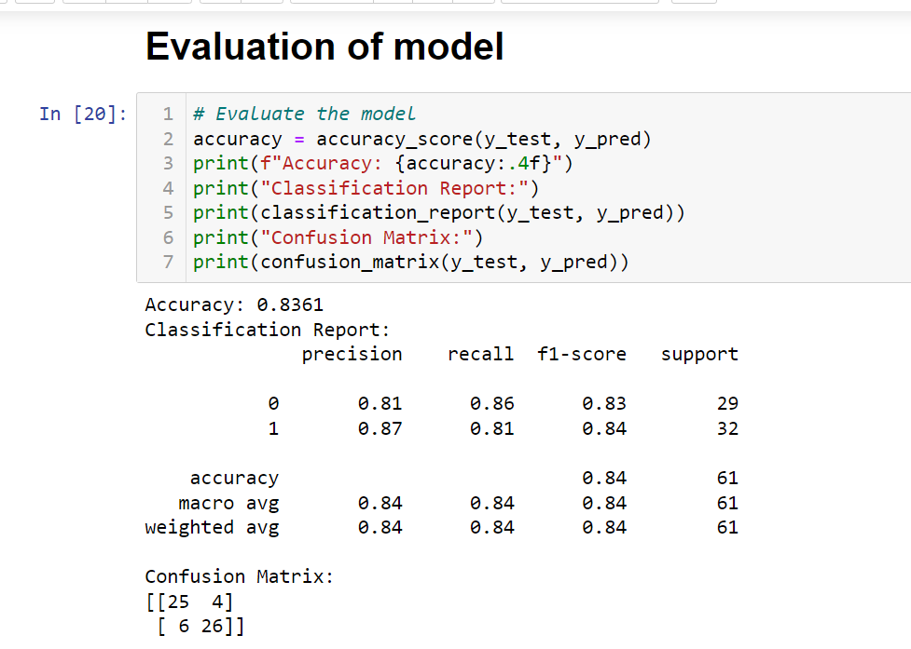
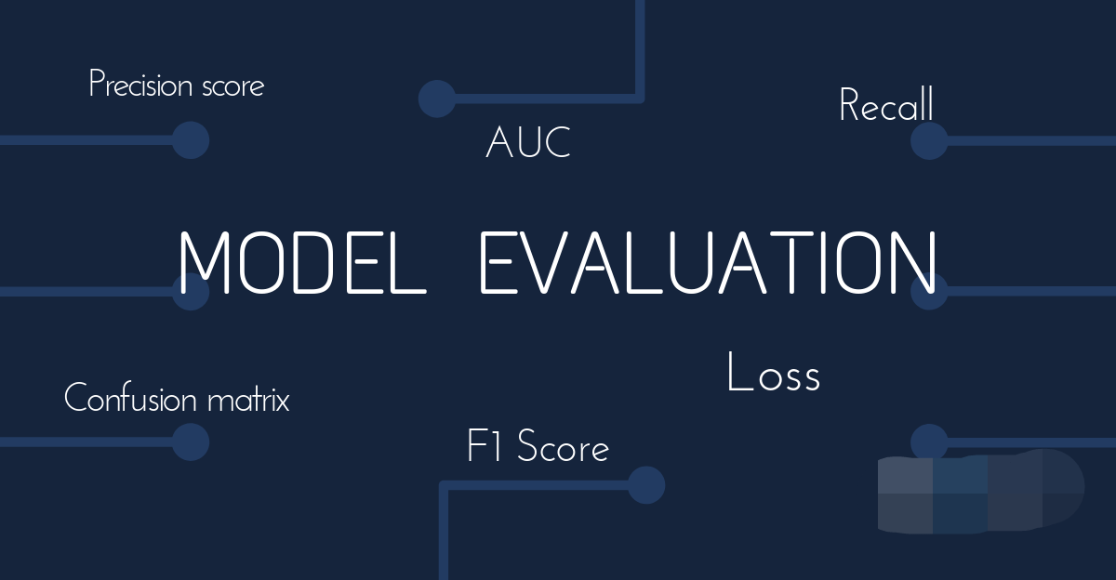
Model Evaluation

Slide 14
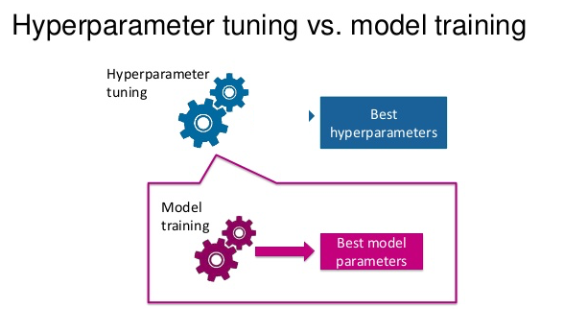
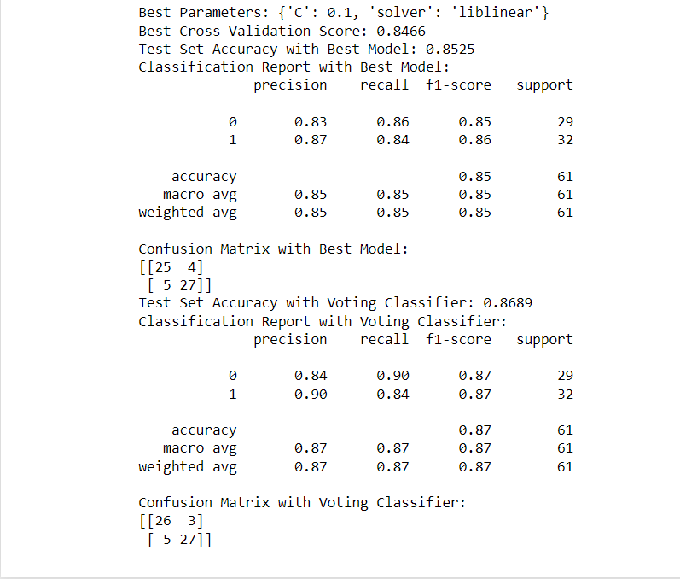
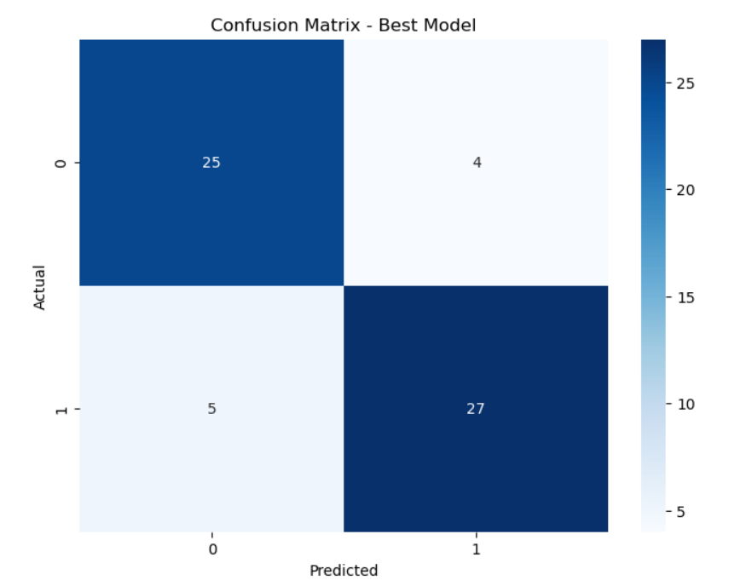
Hyper parameter Tuning

Slide 15
Conclusion
I can conclude more females have heart attack rick than males.
We can see the data is balanced i.e.: we can’t find much difference among target.
The model can predict potential outcomes of heart disease, such as the likelihood of experiencing a heart attack , helping to inform treatment plans and lifestyle changes.
Chest pain ,num_vessels, max_hr, are having high feature importance.
Thall , age ,chol ,old peak are having medium feature importance.
Rest_ecg , bloodsugar , gender are having medium feature importance.
Using logistic regression model accuracy is 83% after hyper parameter tuning we can obtain accuracy of 85%.

Slide 16
Thank You

